Slide 1




CS621 Parallel and Distributed Computing
Dr. Muhammad Anwaar Saeed
Dr. Said Nabi
Ms. Hina Ishaq

Slide 2
CS621 Parallel and Distributed Computing
Performance and Scalability

Slide 3
Objectives
What is performance?
Introduction to Analytical Modeling

Slide 4
What is Performance?
“Computation performance is a measure of how well a computer system can execute a given set of instructions. It can be measured in terms of execution time, overhead, speedup, and cost among others.

Slide 5


Analytical Modeling - Basics
The parallel runtime of a program depends on the input size, the number of processors, and the communication parameters of the machine.
A sequential algorithm is evaluated by its runtime (in general, asymptotic runtime as a function of input size).

Slide 6
Analytical Modeling - Basics
An algorithm must therefore be analyzed in the context of the underlying platform.
The asymptotic runtime of a sequential program is identical on any serial platform.
The parallel runtime of a program depends on the input size, the number of processors, and the communication parameters of the machine.

Slide 7
A number of performance measures are intuitive
Wall clock time - the time from the start of the first processor to the stopping time of the last processor in a parallel ensemble. But how does this scale when the number of processors is changed of the program is ported to another machine altogether?
How much faster is the parallel version?
This begs the obvious follow up question –
what's the baseline serial version with which we compare?
Can we use a suboptimal serial program to make our parallel program look .
Raw FLOP count - What good are FLOP counts when they don't solve a problem?

Slide 8
CS621 Parallel and Distributed Computing
Sources of Overhead in Parallel Programs

Slide 9
Objectives
Introduction Execution Overhead.
Sources of Overhead in Parallel Programs

Slide 10
Sources of Overhead in Parallel Programs
If I use two processors, should not my program run twice as fast?
No - a number of overheads, including wasted computation, communication, idling, and contention cause degradation in performance.

Slide 11
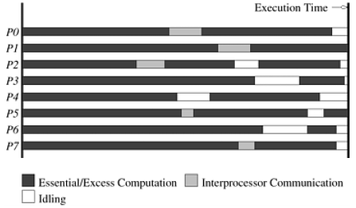
Sources of Overhead in Parallel Programs
The execution profile of a hypothetical parallel program executing on eight processing elements.
Profile indicates times spent performing computation (both essential and excess), communication, and idling.

Slide 12
Sources of Overheads in Parallel Programs
Inter-process interactions:
Idling:
Processors working on any non-trivial parallel problem will need to talk to each other.
Processes may idle because of load imbalance, synchronization, or serial components.

Slide 13
Sources of Overheads in Parallel Programs
Excess Computation:
The difference in computation performed by the parallel program and the best serial program is the excess computation overhead incurred by the parallel program.
This is computation not performed by the serial version.
This might be because the serial algorithm is difficult to parallelize, or that some computations are repeated across processors to minimize communication.

Slide 14
CS621 Parallel and Distributed Computing
Performance Metrics for Parallel Systems

Slide 15
Objectives
Serial vs Parallel Performance.
Performance Metrics

Slide 16
Performance Metrics for Parallel Systems
It is important to study the performance of parallel programs with a view to determining the best algorithm, evaluating hardware platforms, and examining the benefits from parallelism.
A number of metrics have been used based on the desired outcome of performance analysis.

Slide 17
Performance Metrics for Parallel Systems: Execution Time
Serial runtime of a program is the time elapsed between the beginning and the end of its execution on a sequential computer.
The parallel runtime is the time that elapses from the moment the first processor starts to the moment the last processor finishes execution.
We denote the serial runtime by T_{S} and the parallel runtime by T_{P} .

Slide 18
Performance Metrics: Total Parallel Overhead/Overhead function
The total time collectively spent by all the processing elements over and above that required by the fastest known sequential algorithm for solving the same problem on a single processing element.
Let T_{all} be the total time collectively spent by all the processing elements and T_{S} is the serial time.
T_{all} - T_{S} is then the total time spend by all processors combined in non-useful work. This is called the total overhead.

Slide 19
Performance Metrics: Total Parallel Overhead/Overhead function
The total time collectively spent by all the processing elements
T_{all} = p T_{P} (p is the number of processors).
The overhead function (T_{o}) is therefore given by
T_{o} = p T_{P} - T_{S}

Slide 20
CS621 Parallel and Distributed Computing
Performance Metrics for Parallel Systems: Speedup

Slide 21
Objectives
Introduction to Speedup.
Speedup Example

Slide 22
Performance Metrics for Parallel Systems: Speedup
“Speedup (S) is the ratio of the time taken to solve a problem on a single processor to the time required to solve the same problem on a parallel computer with p identical processing elements”

Slide 23
Performance Metrics: Example
Consider the problem of adding n numbers by using n processing elements.
If n is a power of two, we can perform this operation in log n steps by propagating partial sums up a logical binary tree of processors.

Slide 24
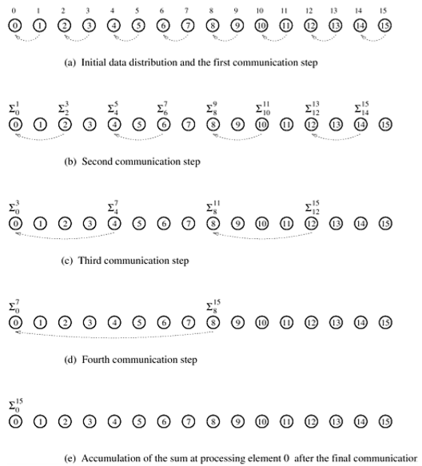
Performance Metrics: Example Cont..
This figure illustrates the procedure for n = 16.
The processing elements are labeled from 0 to 15.
Similarly, the 16 numbers to be added are labeled from 0 to 15.
The sum of the numbers with consecutive labels from i to j is denoted by Σ^{j}_{i} .
Each step shown in Figure consists of one addition and the communication of a single word.

Slide 25
Performance Metrics: Example Cont..
If an addition takes constant time, say, t_{c} and communication of a single word takes time t_{s} + t_{w},
we have the parallel time
T_{P} = Θ (log n)
We know that T_{S} = Θ (n)
Speedup S is given by S = Θ (n / log n)

Slide 26
Performance Metrics: Speedup
For a given problem, there might be many serial algorithms available. These algorithms may have different asymptotic runtimes and may be parallelizable to different degrees.
For the purpose of computing speedup, we always consider the best sequential program as the baseline.

Slide 27
Performance Metrics: Speedup Example
What if serial quicksort only took 30 seconds? In this case, the speedup is 30/40 = 0.75. This is a more realistic assessment of the system. .
The parallel time for odd-even sort (efficient parallelization of bubble sort) is 40 seconds
Consider the problem of parallel bubble sort.
The speedup would appear to be 150/40 = 3.75.
The serial time for bubble sort is 150 seconds.
But is this really a fair assessment of the system?

Slide 28
Performance Metrics: Speedup Bounds
Speedup can be as low as 0 (the parallel program never terminates).
Speedup can never exceed the number of processing elements, p.
A speedup greater than p is possible only if each processing element spends less than time T_{S} / p solving the problem
In this case, a single processor could be time-slided to achieve a faster serial program, which contradicts our assumption of fastest serial program as basis for speedup.

Slide 29
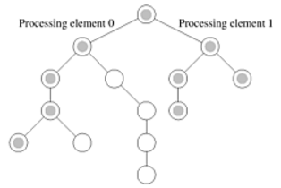
Performance Metrics: Super-linear Speedups
The phenomenon when the speedup become greater than p is known as superlinear speedup.
One reason for super linearity is that the parallel version does less work than corresponding serial algorithm.

Slide 30
Performance Metrics: Super-linear Speedups
Resource-based super-linearity:
The higher aggregate cache/memory bandwidth can result in better cache-hit ratios, and therefore super-linearity.
Example:
A processor with 64KB of cache yields an 80% hit ratio. If two processors are used, since the problem size/processor is smaller, the hit ratio goes up to 90%. Of the remaining 10% access, 8% come from local memory and 2% from remote memory.
If DRAM access time is 100 ns, cache access time is 2 ns, and remote memory access time is 400ns, this corresponds to a speedup of 2.43!

Slide 31
Performance Metrics: Efficiency
Efficiency is a measure of the fraction of time for which a processing element is usefully employed
Mathematically, it is given by
$E=\frac{S}{T}$
Mathematically, it is given by
𝐸=𝑆/𝑇
Following the bounds on speedup, efficiency can be as low as 0 and as high as 1.

Slide 32

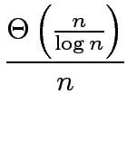
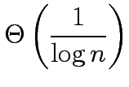


Performance Metrics: Super-linear Speedups
The speedup of adding numbers on processors is given by
Efficiency is given by
$$E=$$
$$=$$

Slide 33
Cost of a Parallel System
Cost is the product of parallel runtime and the number of processing elements used (p x T_{P} ).
Since E = T_{S} / p T_{P}, for cost optimal systems, E = O(1).
Cost reflects the sum of the time that each processing element spends solving the problem.
A parallel system is said to be cost-optimal if the cost of solving a problem on a parallel computer is asymptotically identical to serial cost.
Cost is sometimes referred to as work or processor-time product

Slide 34
Cost of a Parallel System: Example
The cost of this system is given by p T_{P} = n log n.
Consider the problem of adding numbers on processors
We have, T_{P} = log n (for p = n).
Since the serial runtime of this operation is Θ(n), the algorithm is not cost optimal.

Slide 35
Impact of Non-Cost Optimality
The p T_{P} product of this algorithm is n (log n)².
Consider a sorting algorithm that uses n processing elements to sort the list in time (log n)².
Since the serial runtime of a (comparison-based) sort is n log n, the speedup and efficiency of this algorithm are given by n / log n and 1 / log n, respectively.
This algorithm is not cost optimal but only by a factor of log n.

Slide 36
Impact of Non-Cost Optimality
This speedup goes down as the problem size n is increased for a given p !.
If p < n, assigning n tasks to p processors gives T_{P} = n (log n)² / p
The corresponding speedup of this formulation is
p / log n.

Slide 37
CS621 Parallel and Distributed Computing
Scalability of Parallel Systems

Slide 38
Objectives
The effect of Granularity on Performance.
Introduction to Scalability of Parallel Systems
Scaling Characteristics

Slide 39
Effect of Granularity on Performance
Often, using fewer processors improves performance of parallel systems.
Using fewer than the maximum possible number of processing elements to execute a parallel algorithm is called scaling down a parallel system.
A naive way of scaling down is to think of each processor in the original case as a virtual processor and to assign virtual processors equally to scaled down processors.

Slide 40
Effect of Granularity on Performance
Since the number of processing elements decreases by a factor of n / p, the computation at each processing element increases by a factor of n / p.
The communication cost should not increase by this factor since some of the virtual processors assigned to a physical processors might talk to each other.
This is the basic reason for the improvement from building granularity.

Slide 41
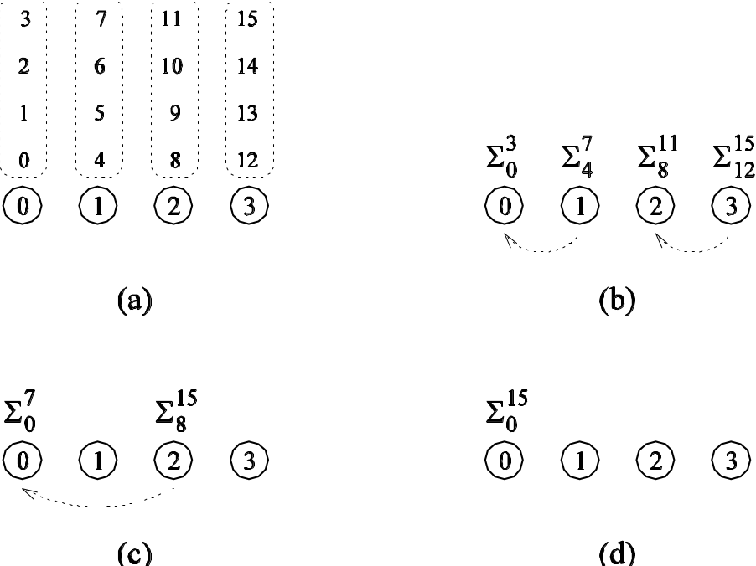
Scalability of Parallel Systems
Can we build granularity in the previous example in a cost-optimal fashion?
Each processing element locally adds its n / p numbers in time Θ (n / p).
The p partial sums on p processing elements can be added in time Θ(n /p).
A cost-optimal way of computing the sum of 16 numbers using four processing elements.

Slide 42
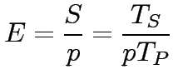

Scaling Characteristics of Parallel Programs
The efficiency of a parallel program can be written as:
or
The total overhead function T_{o} is an increasing function of p.

Slide 43





Scaling Characteristics of Parallel Programs: Example
Consider the problem of adding numbers on processing elements.
We have seen that:
These expressions can be used to calculate the speedup and efficiency for any pair of n and p

Slide 44
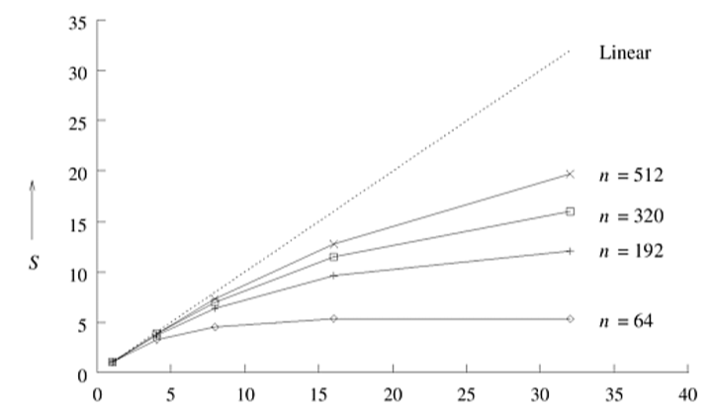
Scaling Characteristics of Parallel Programs: Example (cont.)
Plotting the speedup for various input sizes gives us:
Speedup versus the number of processing elements for adding a list of numbers.
Speedup tends to saturate and efficiency drops as a consequence of Amdahl's law

Slide 45
Scaling Characteristics of Parallel Programs
Total overhead function T_{o} is a function of both problem size T_{s} and the number of processing elements p.
In many cases, To grows sub-linearly with respect to Ts.
In such cases, the efficiency increases if the problem size is increased keeping the number of processing elements constant.
For such systems, we can simultaneously increase the problem size and number of processors to keep efficiency constant.
We call such systems scalable parallel systems.

Slide 46
Scaling Characteristics of Parallel Programs
Recall that cost-optimal parallel systems have an efficiency of Θ(1).
Scalability and cost-optimality are therefore related.
A scalable parallel system can always be made cost-optimal if the number of processing elements and the size of the computation are chosen appropriately.

Slide 47
CS621 Parallel and Distributed Computing
Isoefficiency Metric of Scalability

Slide 48
Objectives
Isoefficiency Metric
Isoefficiency Metric Example

Slide 49
Isoefficiency Metric of Scalability
For some systems, the efficiency of a parallel system increases if the problem size is increased while keeping the number of processing elements constant.
For a given problem size, as we increase the number of processing elements, the overall efficiency of the parallel system goes down for all systems.

Slide 50
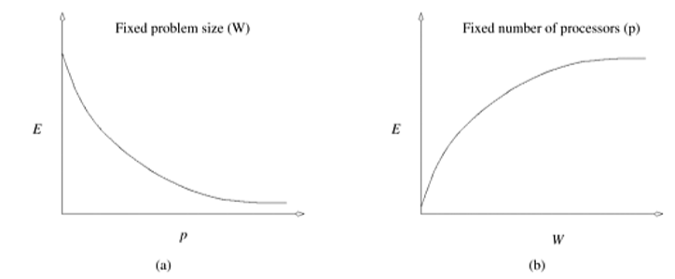
Isoefficiency Metric of Scalability
Variation of efficiency: (a) as the number of processing elements is increased for a given problem size; and (b) as the problem size is increased for a given number of processing elements.
The phenomenon illustrated in graph (b) is not common to all parallel systems.

Slide 51
Isoefficiency Metric of Scalability
What is the rate at which the problem size must increase with respect to the number of processing elements to keep the efficiency fixed?
This rate determines the scalability of the system. The slower this rate, the better.
Before we formalize this rate, we define the problem size W as the asymptotic number of operations associated with the best serial algorithm to solve the problem.

Slide 52
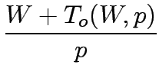


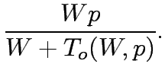
Isoefficiency Metric of Scalability
We can write parallel runtime as:
The resulting expression for speedup is

Slide 53

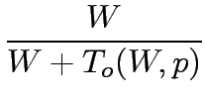

Isoefficiency Metric of Scalability
Finally, we write the expression for efficiency as:

Slide 54

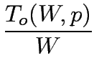
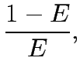
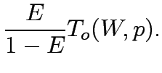


Isoefficiency Metric of Scalability
For scalable parallel systems, efficiency can be maintained at a fixed value (between 0 and 1) if the ratio T_{o} / W is maintained at a constant value.
For a desired value E of efficiency,
If K = E / (1 – E) is a constant depending on the efficiency to be maintained, since T_{o} is a function of W and p, we have:

Slide 55
Isoefficiency Metric of Scalability
The problem size W can usually be obtained as a function of p by algebraic manipulations to keep efficiency constant.
This function is called the isoefficiency function.
This function determines the ease with which a parallel system can maintain a constant efficiency and hence achieve speedups increasing in proportion to the number of processing elements

Slide 56
Isoefficiency Metric: Example
The overhead function for the problem of adding n numbers on p processing elements is approximately 2p log p .
Substituting T_{o} by 2p log p , we get
$W=$ K 2p log p
Substituting T_{o} by 2p log p , we get
𝑊= K 2p log p
Thus, the asymptotic isoefficiency function for this parallel system is: Θ(p log p )
If the number of processing elements is increased from p to p’, the problem size (in this case, n ) must be increased by a factor of (p’ log p’) / (p log p) to get the same efficiency as on p processing elements.

Slide 57






Isoefficiency Metric: Example
Consider a more complex example where:
Using only the first term of T_{o} in Equation, we get
Using only the second term, Equation yields the following relation between W and p:
The larger of these two asymptotic rates determines the isoefficiency. This is given by Θ(p³)

Slide 58
CS621 Parallel and Distributed Computing
Isoefficiency Function and Performance metrics

Slide 59
Objectives
Lower Bound and the Isoefficiency Function
Degree of Concurrency and Isoefficiency Function

Slide 60
Cost-Optimality and the Isoefficiency Function
A parallel system is cost-optimal if and only if:
pTp = Θ(W)
From this, we have:
W + To(W) = Θ(W)
To (W) = Ο(W)
W = Ω(To ( W, p))
If we have an isoefficiency function f(p), then it follows that the relation W = Ω(f(p)) must be satisfied to ensure the cost-optimality of a parallel system as it is scaled up.

Slide 61
Lower Bound on the Isoefficiency Function
For a problem consisting of W units of work, no more than W processing elements can be used cost-optimally.
The problem size must increase at least as fast as Θ(p) to maintain fixed efficiency; hence, Ω(p) is the asymptotic lower bound on the isoefficiency function.

Slide 62
Degree of Concurrency and the Isoefficiency Function
The maximum number of tasks that can be executed simultaneously at any time in a parallel algorithm is called its degree of concurrency.
If C(W) is the degree of concurrency of a parallel algorithm, then for a problem of size W, no more than C(W) processing elements can be employed effectively.

Slide 63
Degree of Concurrency and the Isoefficiency Function: Example
Consider solving a system of n equations in n variables by using Gaussian elimination (W = Θ(n³))
The n variables must be eliminated one after the other, and eliminating each variable requires Θ(n²) computations.
At most Θ(n²) processing elements can be kept busy at any time.
Since W = Θ(n³) for this problem, the degree of concurrency C(W) is Θ(W^{2/3})
Given p processing elements, the problem size should be at least Ω(p^{3/2}) to use them all.

Slide 64
Minimum Execution Time and Minimum Cost-Optimal Execution Time
$\frac{d}{dp}$T_{P}$= 0$
𝑑/𝑑𝑝T_{P} = 0
Often, we are interested in the minimum time to solution.
We can determine the minimum parallel runtime T_{P}^{min} for a given W by differentiating the expression for T_{P} w.r.t. p and equating it to zero.
If p₀ is the value of p as determined by this equation, T_{P}(p₀) is the minimum parallel time.

Slide 65
Minimum Execution Time: Example
Setting the derivative w.r.t. p to zero, we have p = n/2
${Tp}^{min}=2 logn$
(One may verify that this is indeed a min by verifying that the second derivative is positive).
Setting the derivative w.r.t. p to zero, we have p = n/2
〖𝑇𝑝〗^𝑚𝑖𝑛=2 𝑙𝑜𝑔𝑛
(One may verify that this is indeed a min by verifying that the second derivative is positive).
Consider the minimum execution time for adding n numbers.
T_{P}$= \frac{n}{p}$ + 2 log p$= 0$
Consider the minimum execution time for adding n numbers.
T_{P} = 𝑛/𝑝 + 2 log p = 0
Note: that at this point, the formulation is not cost-optimal.

Slide 66
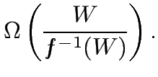

Minimum Cost-Optimal Parallel Time
Let T_{P}^{cost_opt} be the minimum cost-optimal parallel time.
If the isoefficiency function of a parallel system is Θ(f(p)) , then a problem of size W can be solved cost-optimally if and only if W= Ω(f(p)) .
In other words, for cost optimality, p = O(f⁻⁻¹(W)) .
For cost-optimal systems, T_{P} = Θ(W/p) , therefore,
=

Slide 67
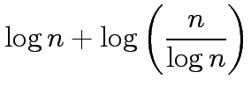

Minimum Cost-Optimal Parallel Time: Example
Consider the problem of adding n numbers.
The isoefficiency function f(p) of this parallel system is Θ(p log p).
From this, we have p ≈ n /log n .
At this processor count, the parallel runtime is:
Note: that both T_{P}^{min} and T_{P}^{cost_opt} for adding n numbers are
Θ(log n). This may not always be the case.
=
=

Slide 68
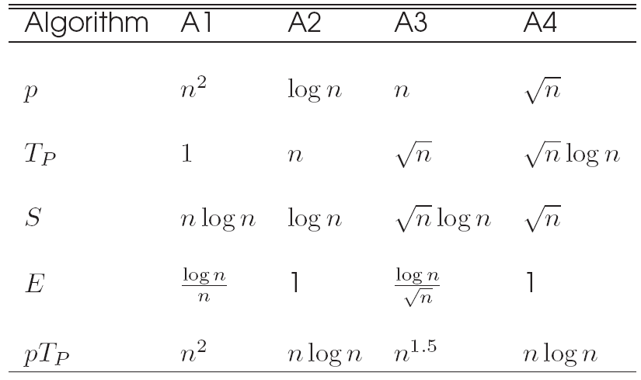
Asymptotic Analysis of Parallel Programs
Consider the problem of sorting a list of n numbers. The fastest serial programs for this problem run in time Θ(n log n). Consider four parallel algorithms, A1, A2, A3, and A4.
Comparison of four different algorithms for sorting a given list of numbers. The table shows number of processing elements, parallel runtime, speedup, efficiency and the pT_{P} product.

Slide 69
Asymptotic Analysis of Parallel Programs
If the metric is speed, algorithm A1 is the best, followed by A3, A4, and A2 (in order of increasing T_{P}).
In terms of efficiency, A2 and A4 are the best, followed by A3 and A1.
In terms of cost, algorithms A2 and A4 are cost optimal, A1 and A3 are not.
It is important to identify the objectives of analysis and to use appropriate metrics!

